Slide 1

Image forgery detection using deep learning
by
Shubhangi Trivedi
Liverpool John Moores University
Under supervision of
Mr. Bikash Santra

Slide 2
introduction
What is the problem?
We now majorly depend a lot on multimedia content
Why should this problem be solved?
What is the significance of this research?
With advancements in technology, it gets very difficult to judge the credibility of any image available, and are accepted by the public without questioning their integrity
we have multiple options available in the market for image editing.
Forged images or the exploited media is now used for malicious purposes.
There is a definitive need for a comprehensive solution to protect the end user from such digital forgeries.
In many cases, images are proof of medical reports and crime scene evidence and such forged image can result in loss of life or escape of convict
we will try to create a model that could detect image forgery effectively and efficiently and thus we can easily verify the authenticity of an image.

Slide 3
Aims and objectives
The objectives of the study based on the aims are following:
To give an overview of different types of techniques that are currently used for image forgery.
To identify the best preprocessing techniques that help in identifying image forgeries better and can generalize image effectively.
To understand working of Error level analysis techniques and how helpful in effective feature extraction
To identify the best state of art model that can help in detecting image forgeries with better accuracy.

Slide 4
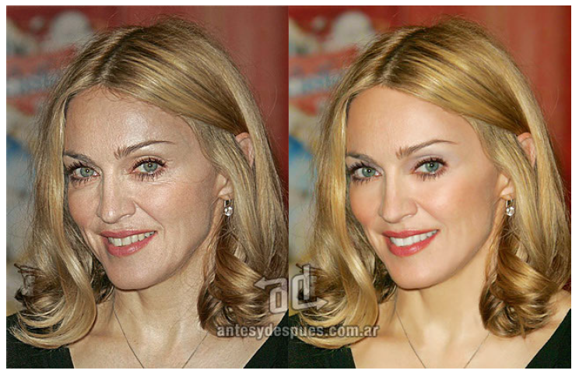
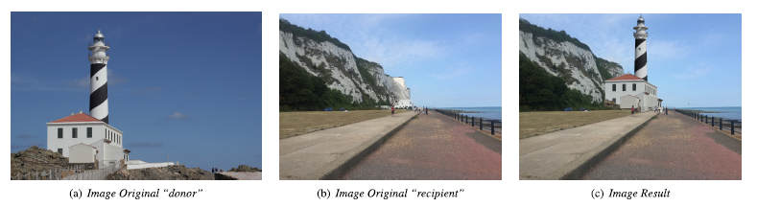
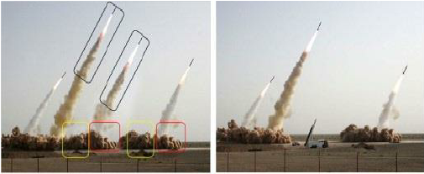
Types of Image forgery
Image forgery can be classified into 3 major category
Image retouching
Splicing
Copy Move

Slide 5
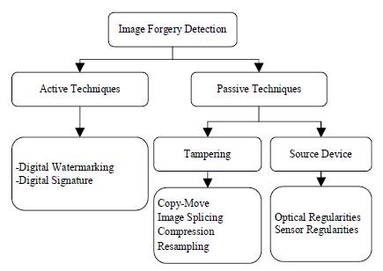
image forgery detection techniques

Slide 6
Literature review
What is digital photography?
Types of image formats
JPEG
TIFF
BMP
Types of image compressions
Lossy
Lossless

Slide 7
Literature review(contd..)
Methods of detecting image tampering used:
Physics-based techniques that explicitly model and detect anomalies in the three-dimensional interaction between physical objects, light, and the camera
Pixel-based techniques that detect statistical abnormalities introduced at the pixel level
Format-based techniques that leverage the statistical correlations introduced by a specific lossy compression scheme
Camera-based techniques that exploit artifacts introduced by the camera lens, sensor, or on-chip postprocessing
Geometry-based techniques that explicitly model and detect anomalies in the three-dimensional interaction between physical objects, light, and the camera

Slide 8
Literature review(contd..)
Advanced Image Tampering techniques:
ELA (Error Level Analysis)
CNN
Transfer Learning using state of art models

Slide 9
Dataset description
For this study we have used CASIA V2.0 dataset.
It contains a total of 12323 colored images which are divided into 7491 original images and 5123 tampered images.
Original images contain an image of the following 9 categories: scene, article, animal, nature, character, architecture, plant, texture, and indoor.
The tampered images are generated by copy-move, resizing, rotation, blurring of edges and distortion.

Slide 10
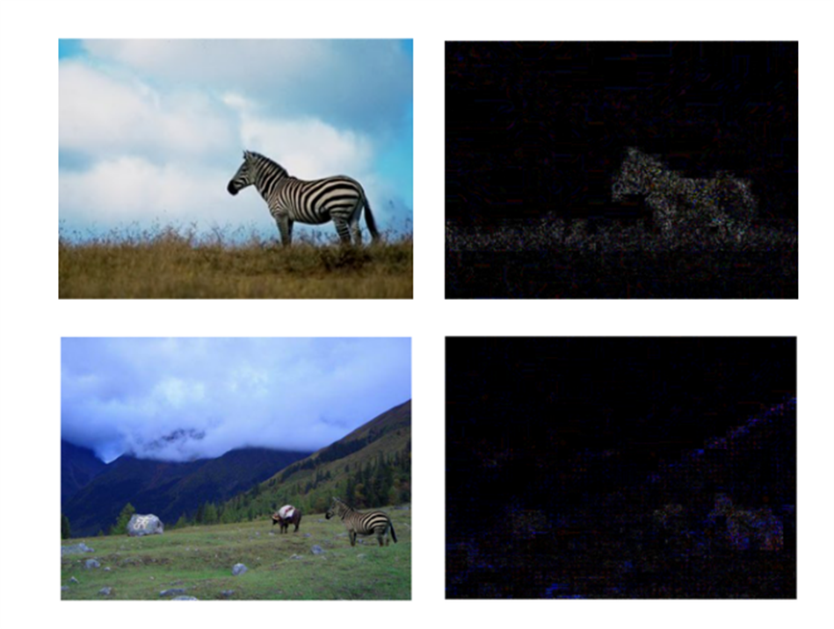
ELA (Error Level analysis)
ELA works by taking a lossy image and recompressing it with a known error rate, after which it computes the absolute difference between the analyzed and recompressed image.

Slide 11
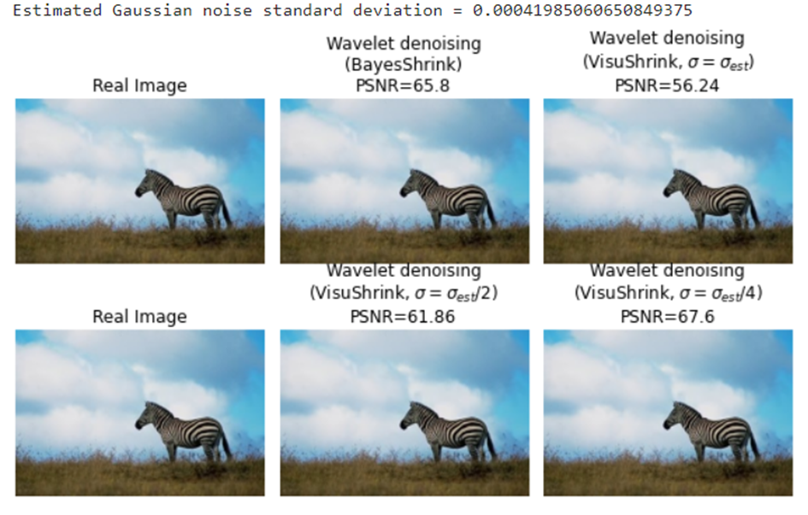
Wavelet denoising
Noise removal using wavelet-based algorithms has been proved to be effective. The discrete wavelet transforms coefficients, which have been modified by additive white Gaussian noise, are thresholder in these methods. For evaluation of denoised images, we are using PSNR index.

Slide 12
Workable Solutions
Solution #1
Used state of art model – VGG16
Solution #2
Used state of art model – RESNET50
We have achieved training accuracy of 99.26% and validation accuracy of 95.01 %, with training and validation loss as 0.0216 and 0.1629 respectively
Solution #3
Used custom CNN model
We have achieved training accuracy of 99.43% and validation accuracy of 94.69 %, with training and validation loss as 0.0176 and 0.1732 respectively
We have achieved training accuracy of 90.44% and validation accuracy of 89.76%, with training and validation loss as 0.2042 and 0.2211 respectively

Slide 13
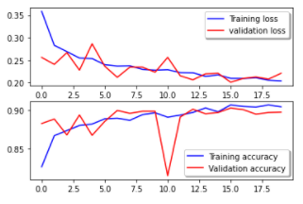
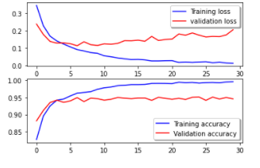
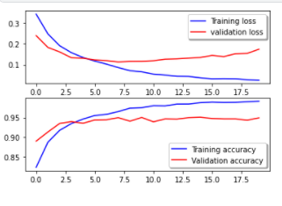
Workable Solutions results
Solution #1
VGG 16
Solution #2
RESNET50
Solution #3
Custom Model

Slide 14
Final Result
ELA is very important pre processing step. This is justified by the use of custom model with ELA which gave us far better performing results that model without ELA and with K fold.
Though the model performance of both RESNET50 and custom model are comparable but we choose custom. For detecting image forgeries, it is important that accuracy of identifying fake images is better than accuracy of identifying real images accurately
 | K fold + Custom Model | RESNET50 | VGG16 | Custom CNN Model
Accuracy | 0.592595529 | 0.949044586 | 0.900212314 | 0.945859873
Precision | 0.515105561 | 0.948293687 | 0.915365502 | 0.94978829
F1 Score | 0.446456835 | 0.947930972 | 0.904405928 | 0.947003701
Confusion Matrix | [[7443 48] [5091 32]] | [[ 317 69] [ 27 1471]] | [[ 345 41] [ 147 1351]] | [[ 359 27] [ 75 1423]]

Slide 15
Future recommendations
Creating deep learning models that can be trained from small dataset. With limited training dataset, robust models are required to boost learning potential. Thus, it is advised that researchers investigate how to create a deep model learning from a tiny training dataset.
Using optimization techniques to tweak the parameters of the model. The number of parameters that must be modified in deep learning CNN models is enormous. To tackle this problem, optimization techniques such as PSO are required. As a result, the proposed model should be capable of automatically extracting the features and needs fewer human interventions.
CASIA V2.0 is slightly imbalanced dataset and to remove imbalance we just took equal number of samples of real and fake images. Despite recent breakthroughs in deep learning and its growing popularity, there is virtually little empirical work on deep learning with class imbalance.

Slide 16
Thank you
For any queries , please reach me out through email: shutrive@gmail.com

